Slide 1
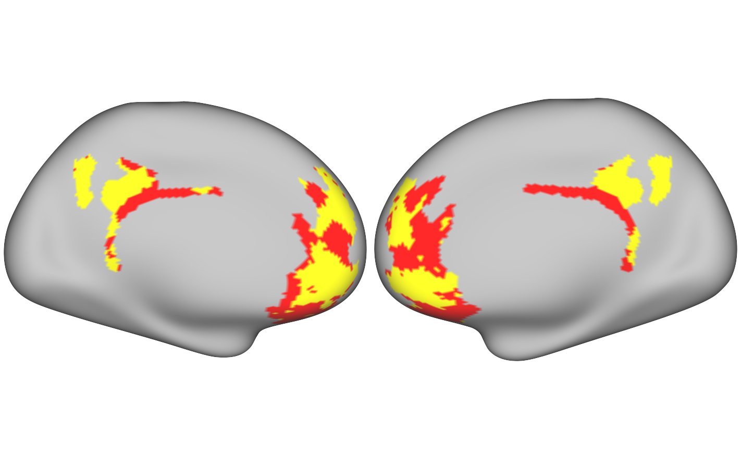
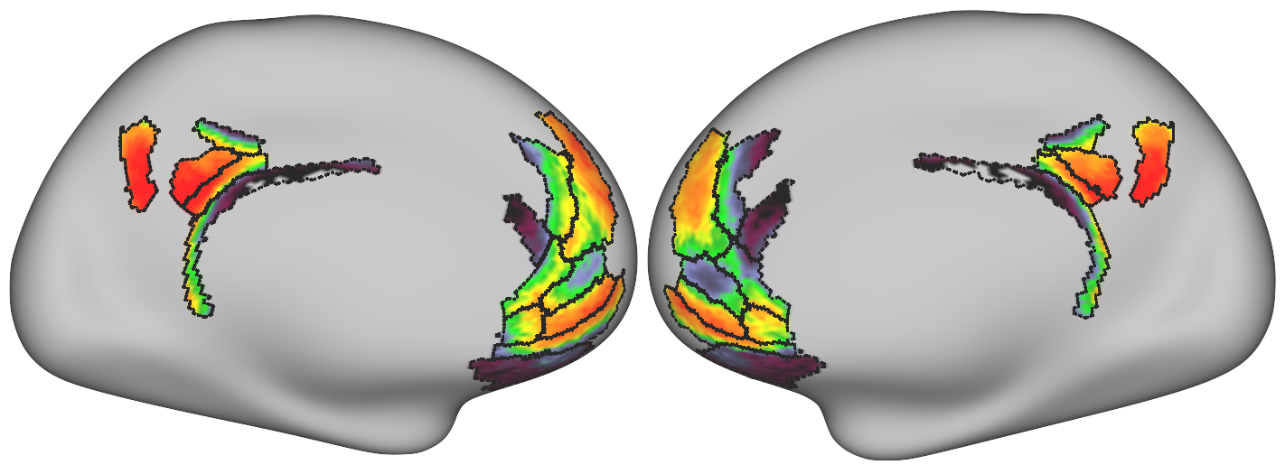
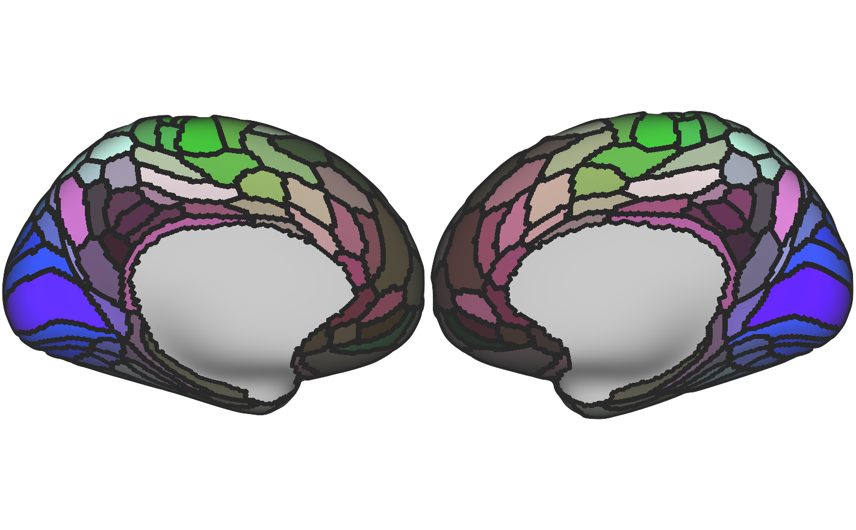
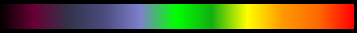
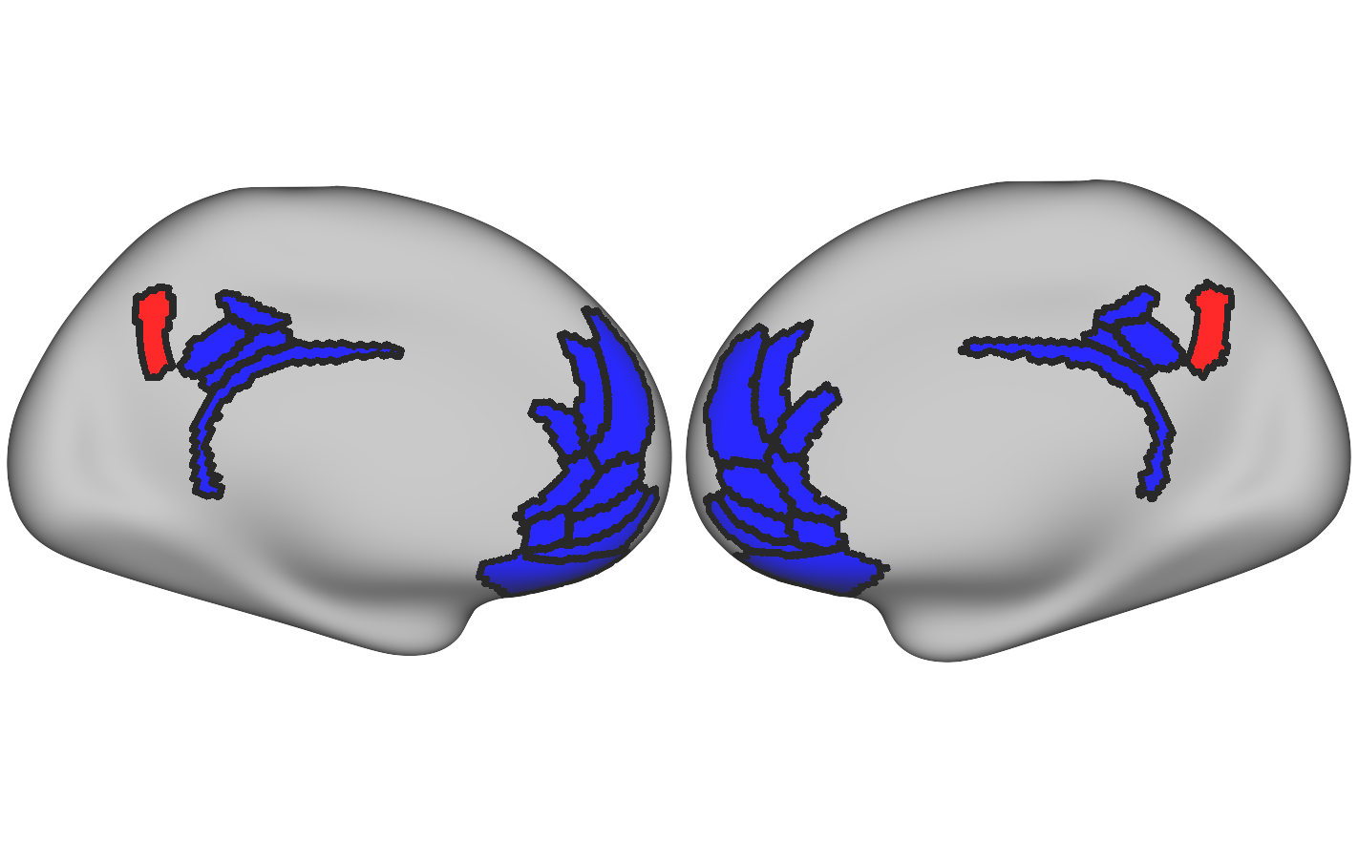
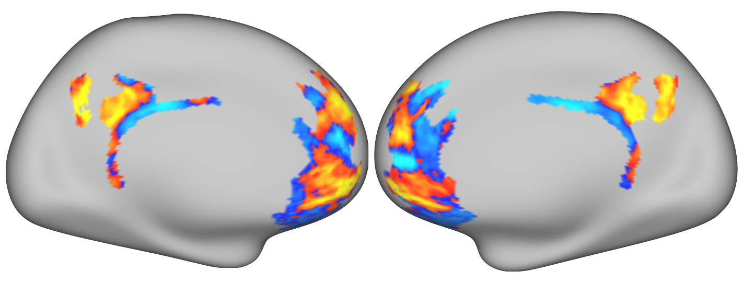
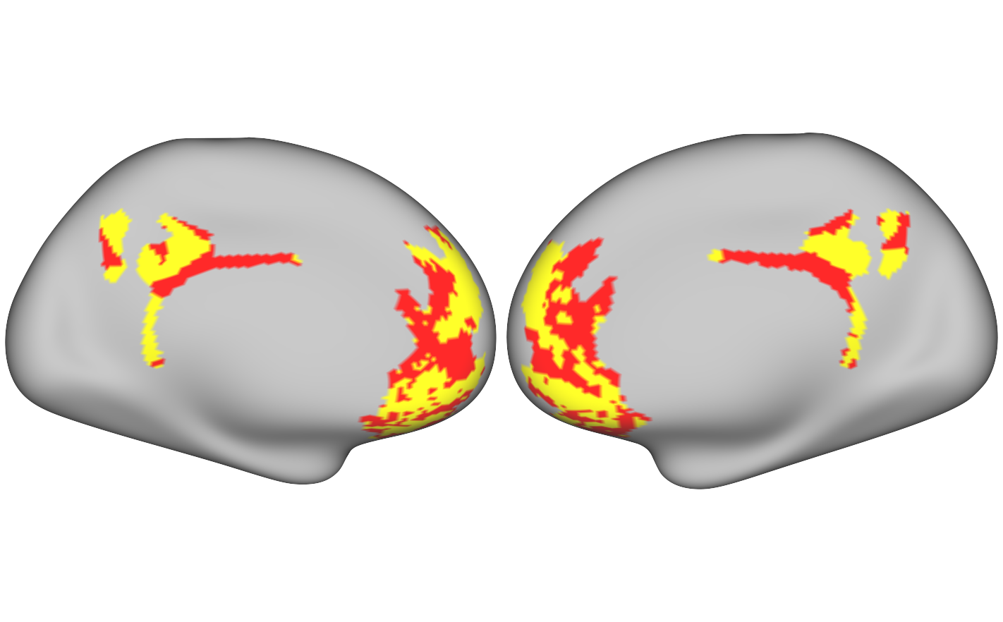
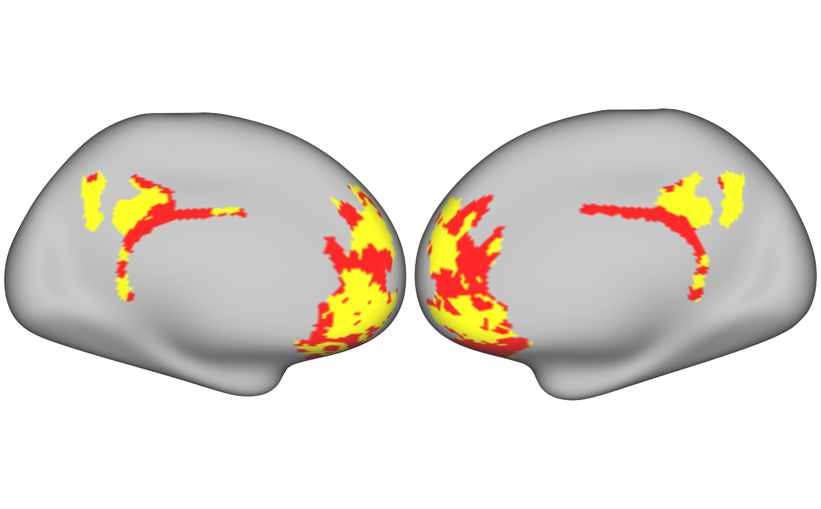
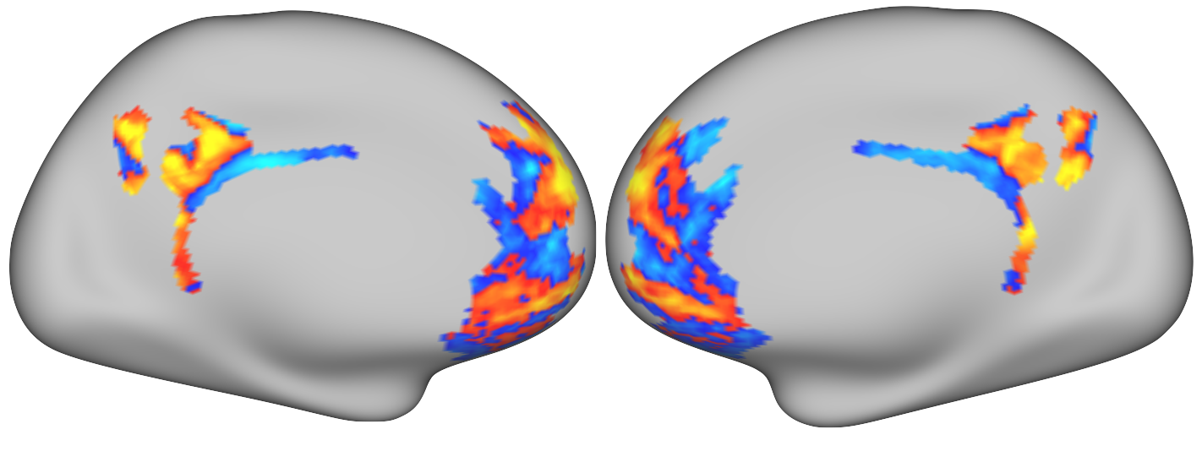
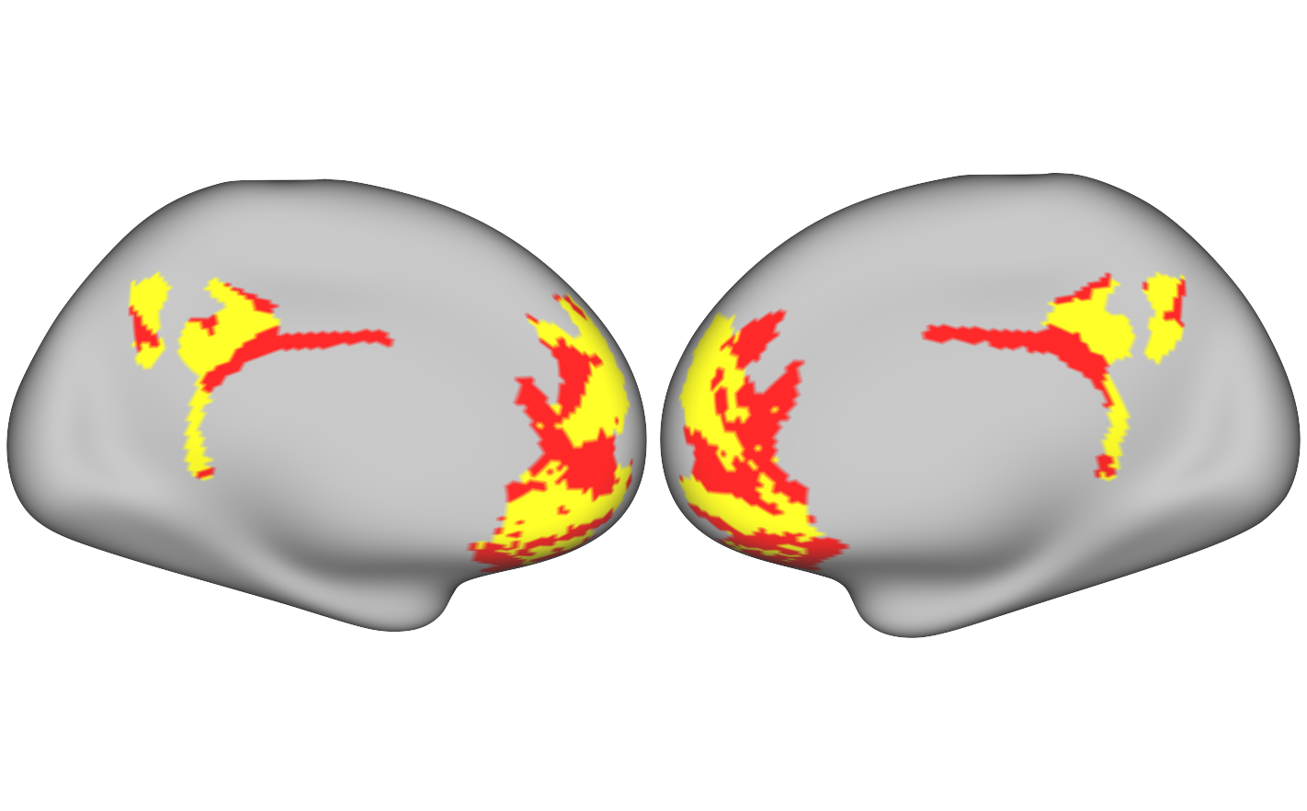
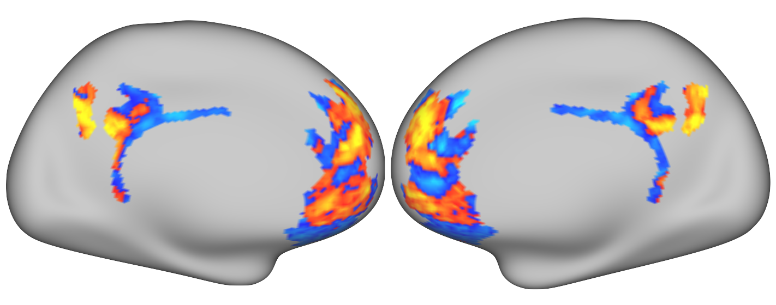
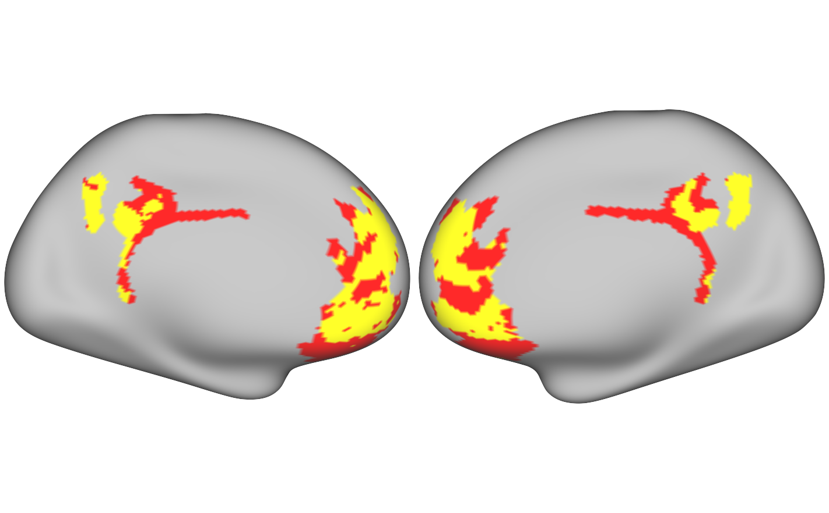
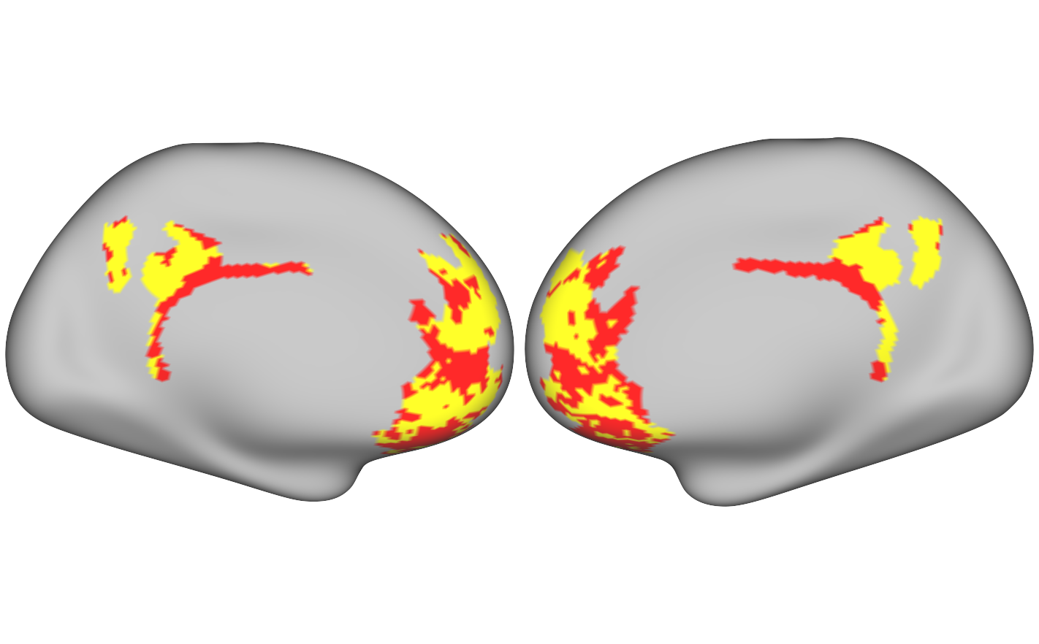
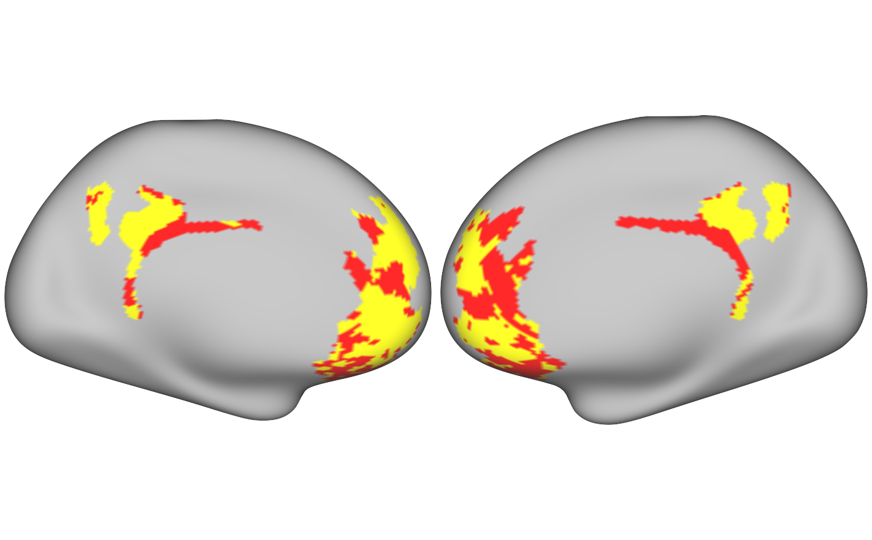
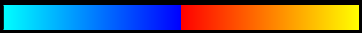
Parsing mPFC: A Joint Meta-Analytic and Graph Theoretic Approach
Claudio Toro-Serey & Joseph T. McGuire
Department of Psychological and Brain Sciences, Boston University, Boston, MA
Introduction
Results
The spatial extent of subjective value (SV) effects is mostly indistinguishable from the default mode network (DMN) in existing meta-analyses.
But little is known about the degree of heterogeneity in the intrinsic functional architecture of mPFC across individuals.
Here we complement a meta-analysis with fMRI-based graph theoretic tools to subdivide mPFC and PCC into DMN/non-DMN at the single subject level.
Community detection
Stereotypical partition for an example subject (100307)
DMN shows dorsal and ventral mPFC coverage, with non-DMN areas in pregenual ACC and OFC.
Greater alignment across subjects in PCC than in mPFC.
PCC: M=0.43, SD=0.1
mPFC: M=0.11, SD=0.1
Spatially averaging the binarized maps reveals both a common topographic structure and individual heterogeneity.
7m
Non-DMN
DMN, as defined by 7m affiliation
Proportion of DMN affiliations across subjects
Methods
Surface parcel-based meta-analysis
Standard cortical atlas
0
0.5
1
Volumetric coordinates extracted from studies of valuation (n = 27; Bartra et al., 2013) and DMN (n = 77; Laird et al., 2009).
10mm spheres per coordinate were projected onto a surface model and mapped to a standard cortical atlas (Glasser et al., 2016), giving the number of times each region was reported in each literature.
Permuted 𝜒² prop tests were used to identify overlapping and unique ROIs between literatures.
Test-retest reliability of individualized patterns
Similarity of daily- and session-based partitions
1
Within- vs between-subject ARI ratios
mPFC
ARI
8
*
Each day and session was analyzed independently.
The mean ARI of within-subject patterns was markedly higher than across subjects, and this ratio was significantly higher for mPFC.
This indicates that mPFC organization is idiosyncratic across individuals.
Day (2 per subject)
0.5
5
SV & DMN
PCC
0
2
Paired perm., Cohen’s D = 2.9
0
DMN > SV
ARI Ratio (Within/Between subj.)
mPFC
1
8
*
Graph-theoretic community detection
ARI
5
Resting-state fMRI data from the Human Connectome Project (Van Essen et al., 2013):
100 subjects x 4 sessions x 1200 TRs.
Subject networks: ROI vertices as nodes (n = 5081), and Pearson correlations of activity in every pair of nodes as edges.
Community: Strongly interconnected groups of nodes that are sparsely connected with other clusters.
Estimated through spectral partitioning, and validated with modularity (high agreement across methods: M=0.85, SD=0.1).
Session (4 per subject)
0.5
PCC
2
Paired perm., Cohen’s D = 2.6
0
0
mPFC
PCC
Pattern stability over time
1
*
Sliding window analysis shows stable agreement with overall pattern across individual time series, but lower for mPFC.
SD over time within subject and within region.
0.5
Density
ARI
Laplacian eigenmaps are generated by spectral partitioning
Binarized to form DMN and non-DMN partitions
Agreement evaluated with the Adjusted Rand Index (ARI)
0
Window (20 mins each)
Paired perm., Cohen’s D = 3.6
0
mPFC
PCC
SD
1
101006
100307
Conclusions
Session 1
0.02
Functional topography of mPFC has substantial variability across individuals.
Spectral partitioning captures stable individualized functional organization even with small amounts of data.
Meta-analytic overlap does not necessarily signify that SV and DMN functions share a common cortical substrate.
0.03
0.02
Within subject
0.13
0.22
Session 4
0.02
-
0
+
Between subjects
Acknowledgements: ONR MURI N00014-16-1-2832 (M. Hasselmo, PI); NSF BCS-1755757 (J. T. McGuire, PI)

